Slide 1
Human Resources Dataset Analysis
Group C

Slide 2
Under Supervision Of:
Presented By:
Prof. Dr/ Wael Mahrous
Rashad Hazem Aly 1112542203 Leader
Mariem Korashi Khalaf 1112760217 Presenter
Basem Barakat Allah 1113635223 Member
Rasha Gaafar Osman 1123640976 Member
Mohamed AbdElAlim 1112535391 Member
Esraa Magdy Elsaid 1110329116 Member

Slide 3

What is HR analytics?
*HR analytics (usually referred to as people analytics or workforce analytics) involves gathering, analysing, and reporting HR data to drive business results.
*HR analytics enables organizations to better understand of their workforce, make decisions based on data, test the effectiveness of HR policies and interventions and measure the impact of a range of HR metrics, ultimately improving overall business performance to as much as a 25% rise in business productivity, a 50% decrease in attrition rates, and 80% increase in recruiting efficiency.
*In other words, HR analytics is a data-driven approach to Human Resources Management.

Slide 4

HR Database:
HR database is a system where you store and manage data on your company’s employees. HR databases can be used to track a variety of information, including HR metrics, which give the HR team insights for better decision-making.
It may include:
Employee’s name, Address, Contact info., Job title, Who they report to, Annual leaves, Benefits, Absenteeism, Skills, Salaries, Training and Development Programs

Slide 5
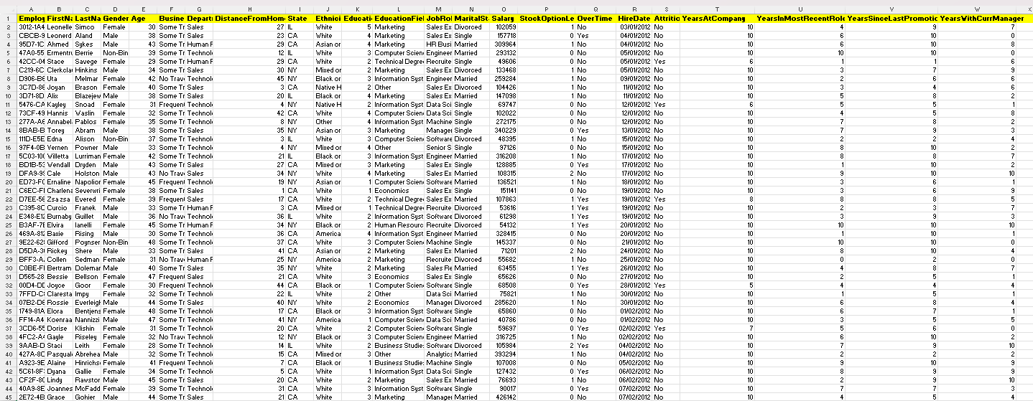
HR Dataset:
Employees Table

Slide 6
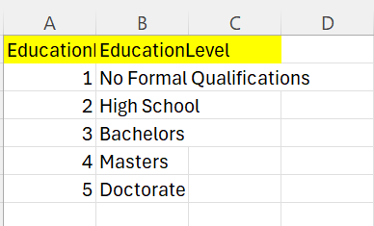
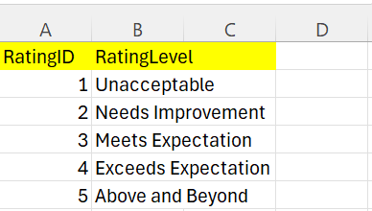
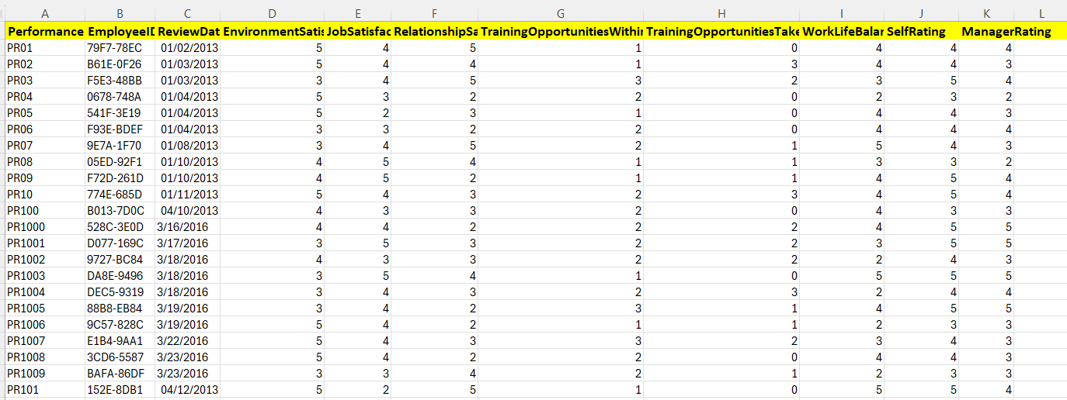
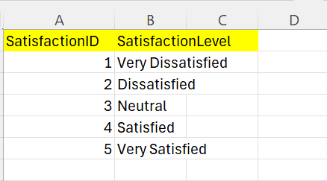
Education Level Table
Rating Level Table
Performance Level Table
Satisfied Level Table

Slide 7
Analyzing the Data:

Slide 8
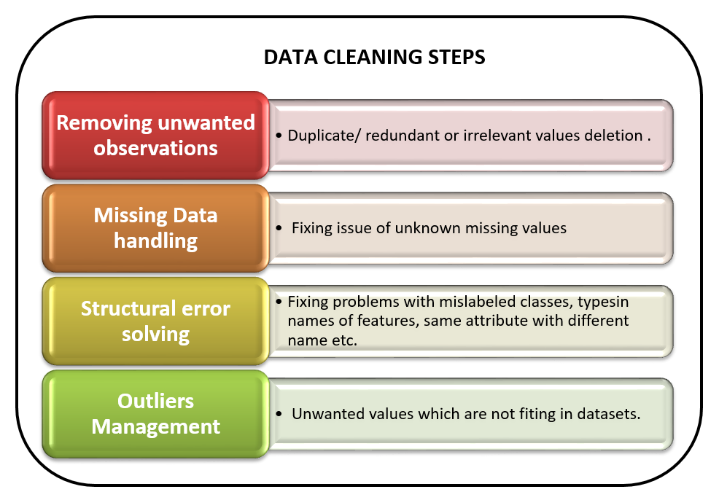
Data Cleaning

Slide 9

Importing Necessary Libraries For Data Cleaning

Slide 10
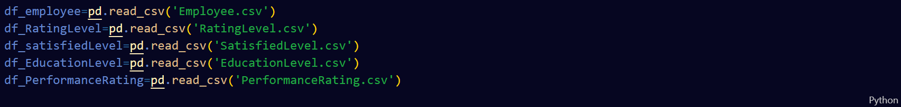
Recalling Data From Its Previous Format (CSV) And Storing It In A Custom Data Frame For Each File

Slide 11
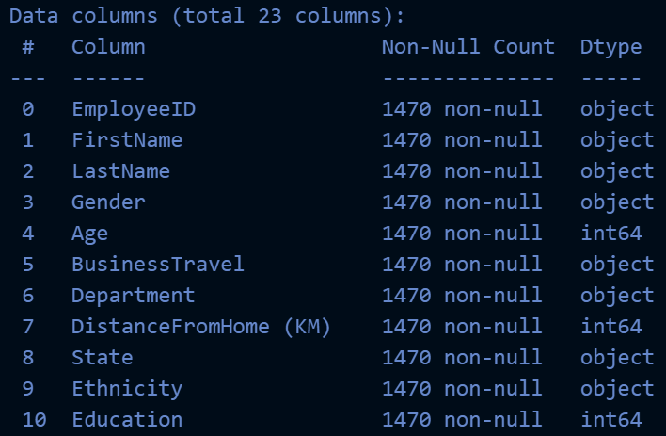
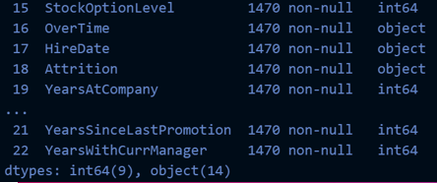
Displaying Information About Employees Table
(No empty values, but HireDate is object Not DateTime)

Slide 12
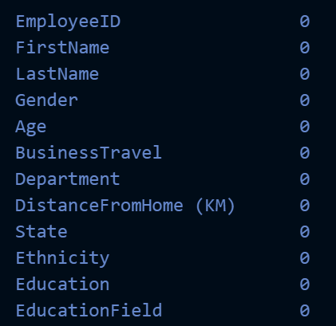
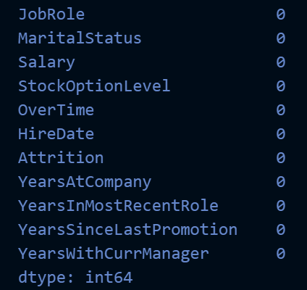
Ensuring No Empty Data Or Nulls In Employees Table
No nulls found

Slide 13
Solving All Problems In Employees Table
Ensured deleting all duplicates in EmployeeID.
Converted the hireDate type from object to datetime.
Collected the first and last name in a table named full name.
Removed fristName and LastName columns.

Slide 14
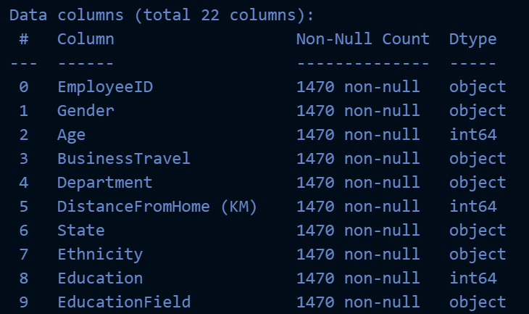
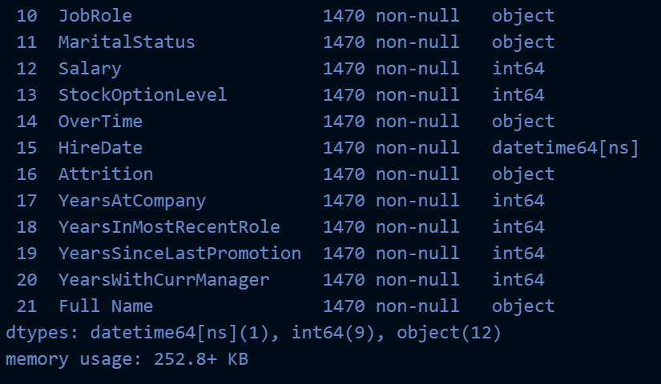
Displaying Employees Table After Cleaning
Ensured everything is well.

Slide 15
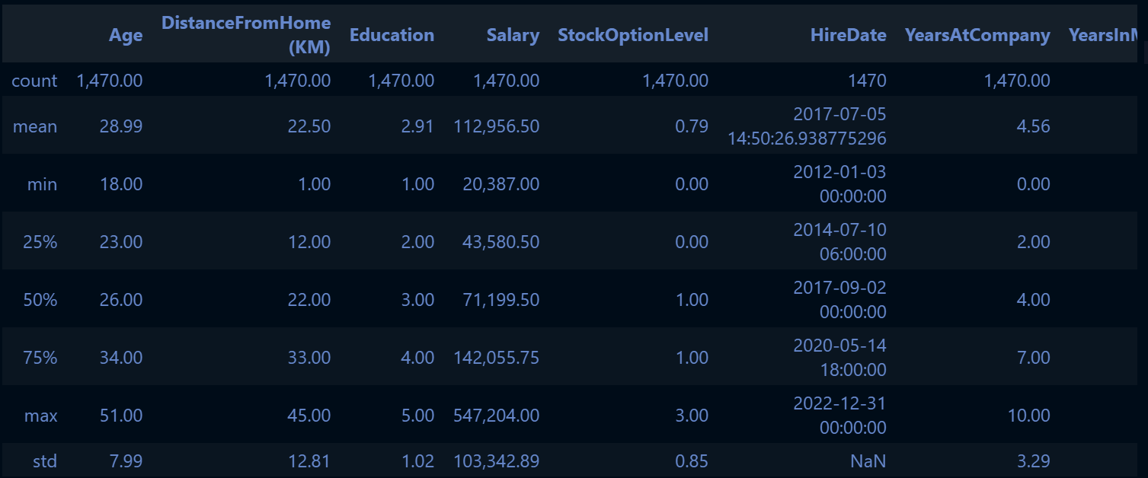
Looking For Any Outlayers In All Tables
By using Python there were no outlayers in any of the tables.

Slide 16
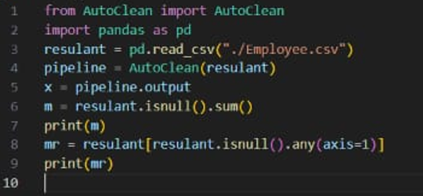
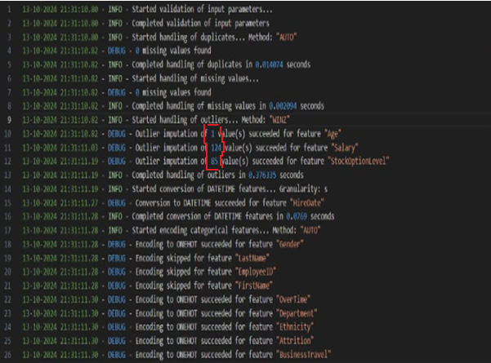
Looking For Any Outlayers In All Tables (Autoclean Library)
Those outlayers had explanation and did not affect the results.
So, they were not deleted.

Slide 17
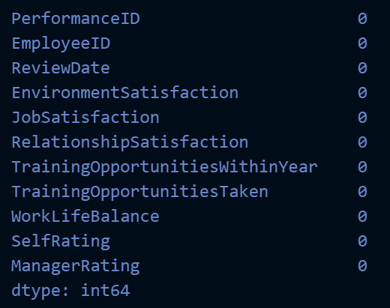
Ensuring No Empty Data Or Nulls In Performance Rating Table
No nulls found

Slide 18
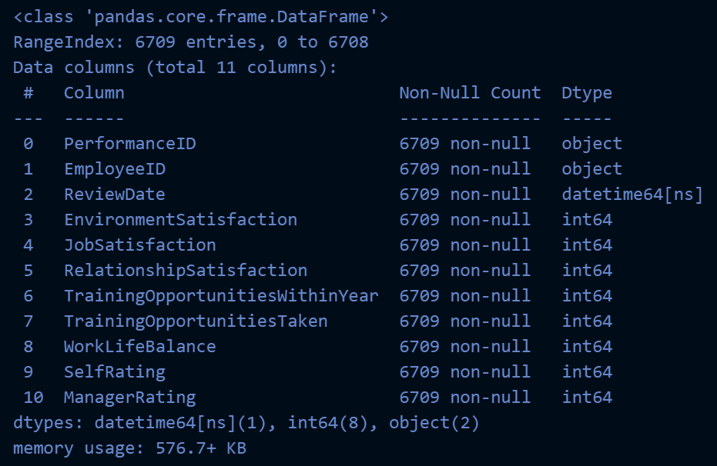
Solving All Problems In Performance Rating Table
Ensured deleting all duplicates in PerformanceID.
Converted the reviewDate type from object to datetime.

Slide 19
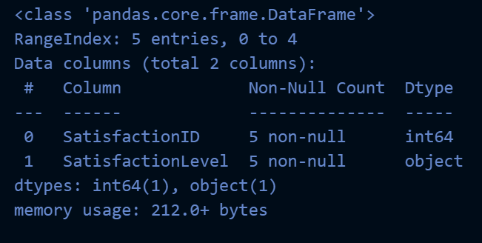
Ensuring No Empty Data Or Nulls In SatisfiedLevel Table And Changing The Columns Names
No nulls found

Slide 20
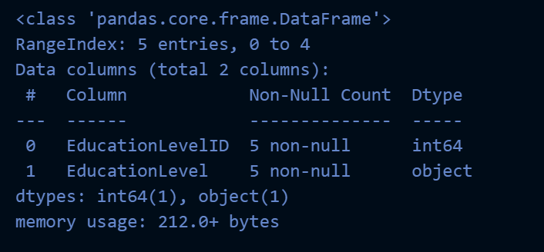
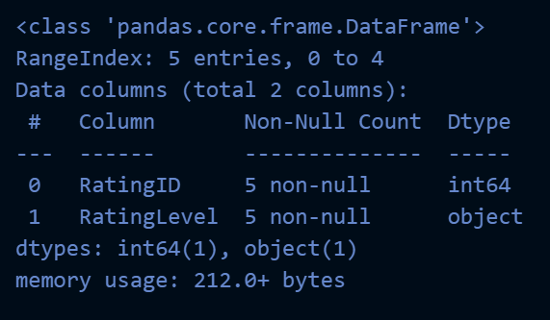
Ensuring No Empty Data Or Nulls In EducationLevel And RatingLevel Table
No nulls found

Slide 21
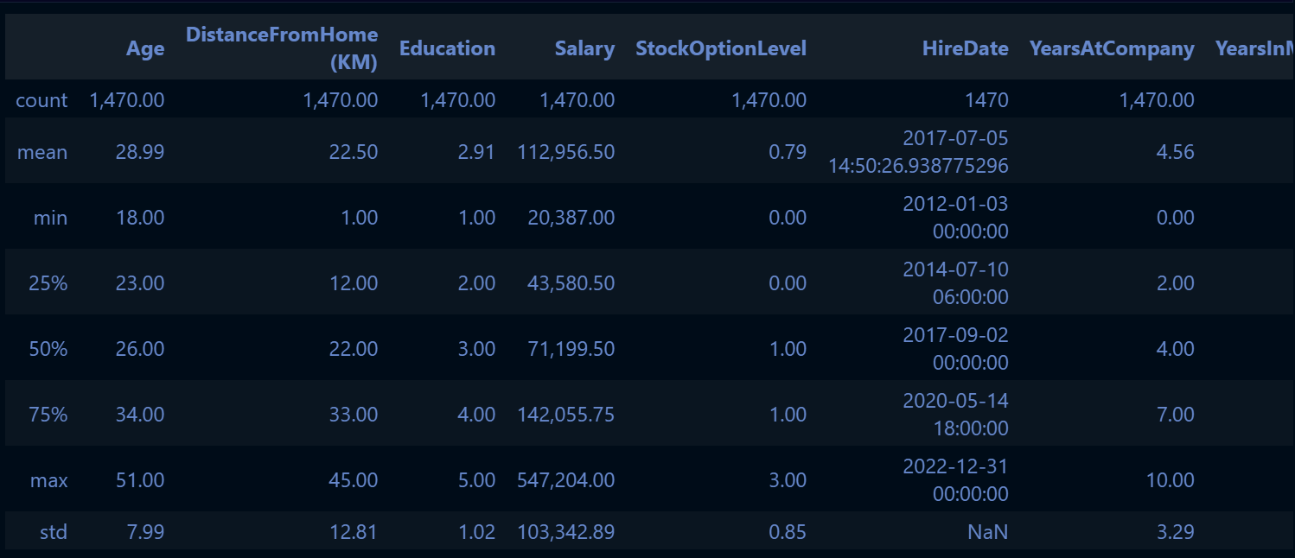
Show Sample From Dataframe

Slide 22
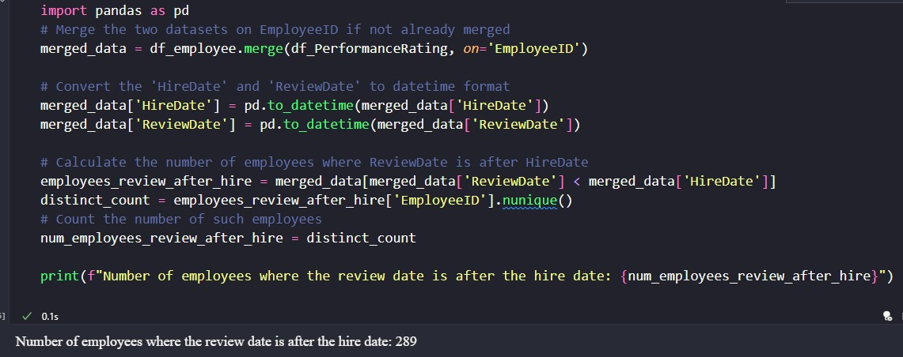
Data Quality
Some employees were found to have review dates in dates before their hiring dates ------ Did No Change

Slide 23
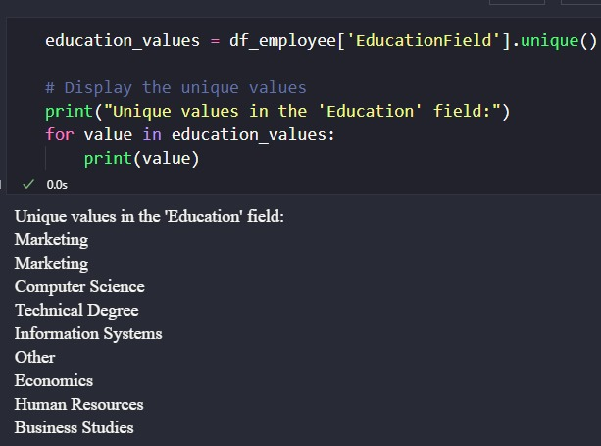
Two education value fields were found to be marketing without any significant difference ----- Did no change.
The Gender column in Employee Table had 2 items beside male and female and both of them could affect the total no. of males and females if known---- No change was done.
It was unethical to put a column for Ethnicity as it was of no value for analytical purposes.
There were many outlayers between employees' salaries-------- No change was done----- as we suggested it may be due to difference in levels of employees, as between general manager and senior staff and normal employees
More sources of data were needed for better understanding, analysing and consequent decision making.

Slide 24
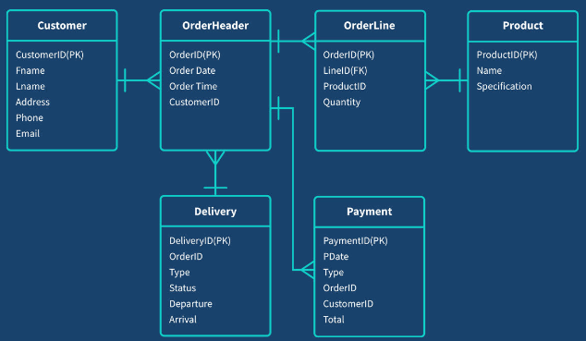
Data Modeling
Data modelling is the process of creating a diagram that represents your data system and defines the structure, attributes, and relationships of your data entities.
Data modelling organizes and simplifies data in a way that makes it easy to understand, manage, and query, while also ensuring data integrity and consistency. Data models inform about data architecture, database design, and restructuring legacy systems.

Slide 25
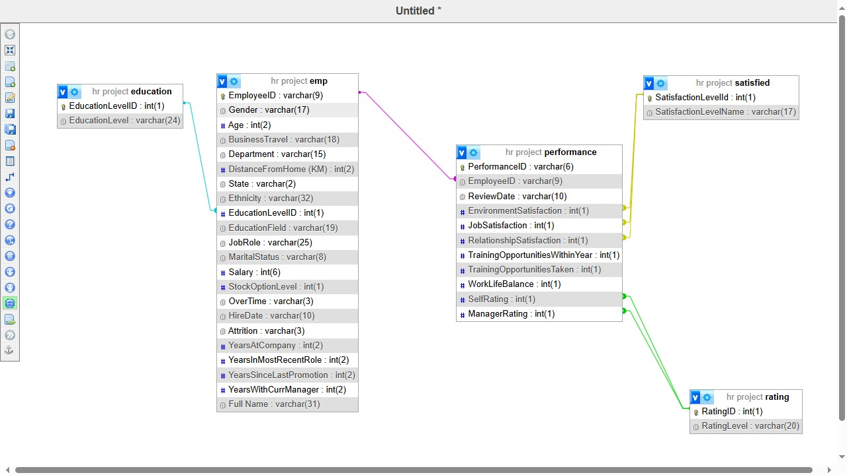
Data Modeling Using SQL

Slide 26
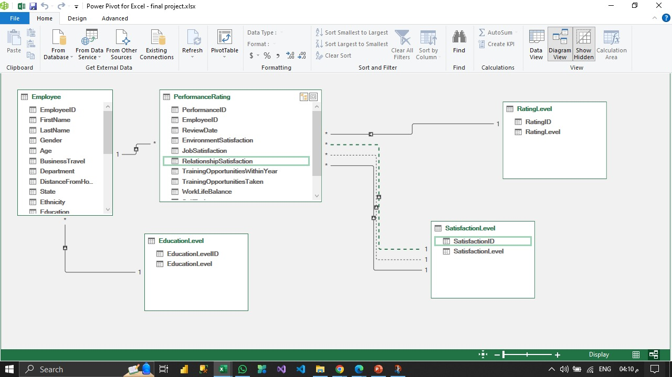
Data Modeling Using Excel

Slide 27

Determining Data Analysis Questions And Answering Them

Slide 28
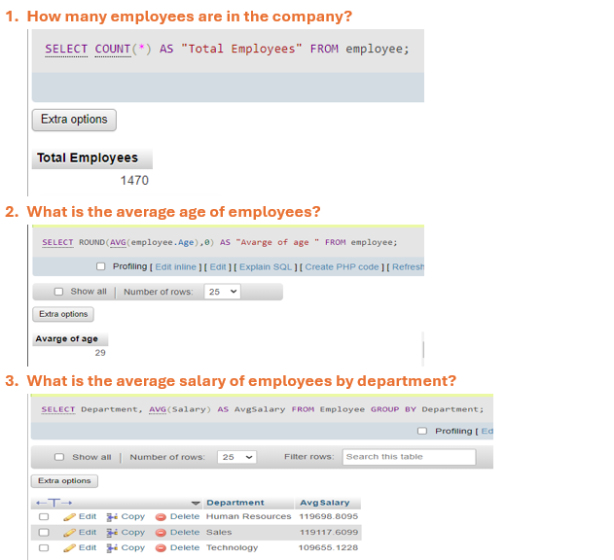

Slide 29
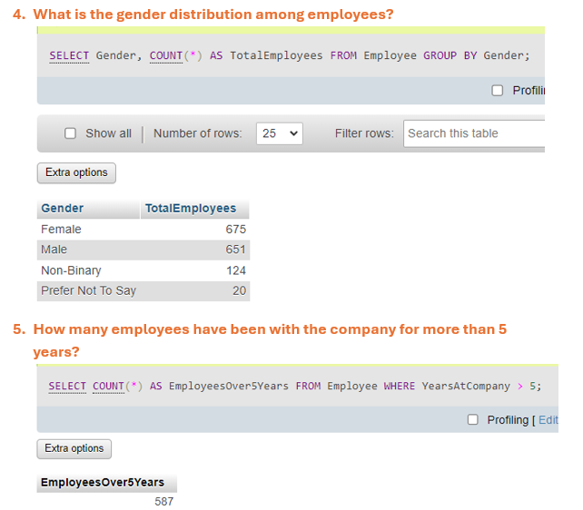
Q1:

Slide 30
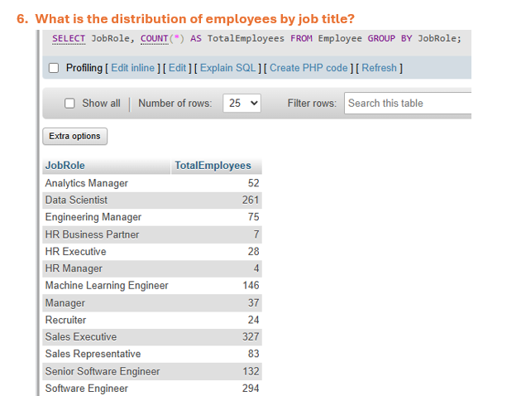
Q2:

Slide 31
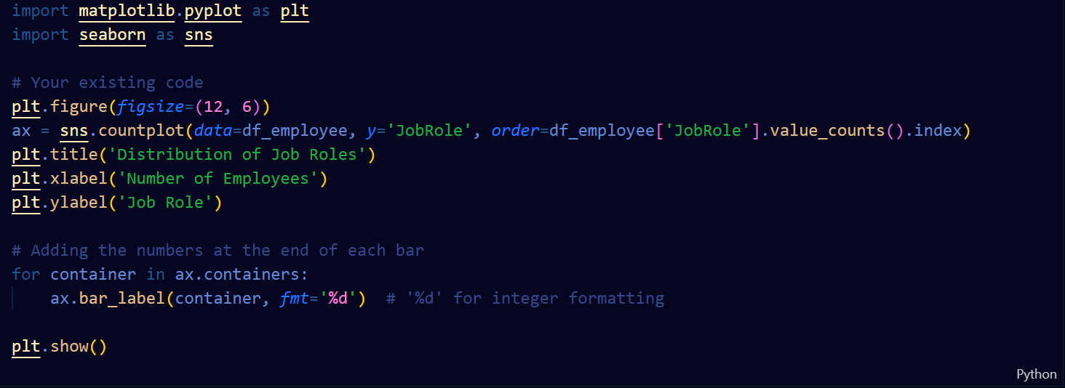
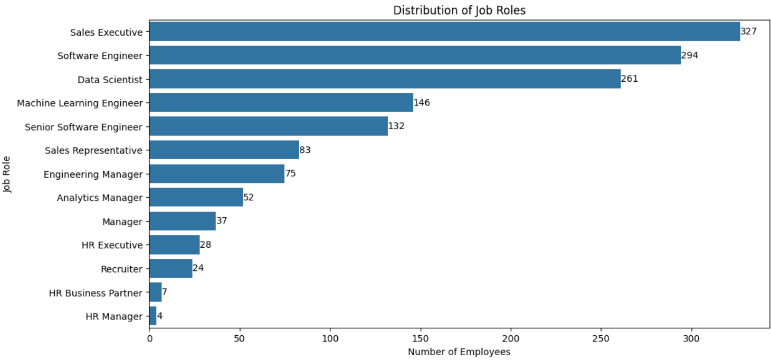

Slide 32
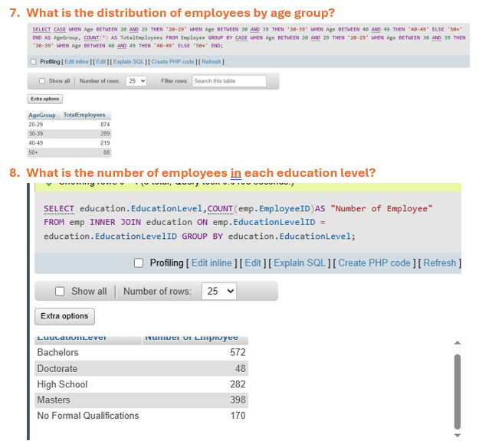

Slide 33
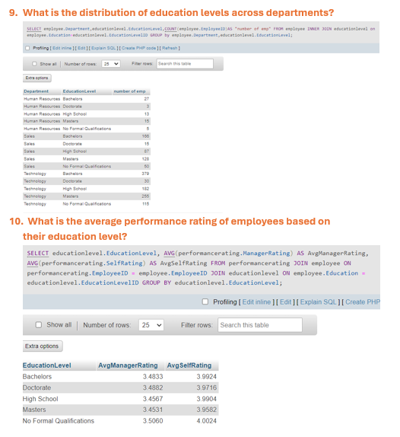

Slide 34
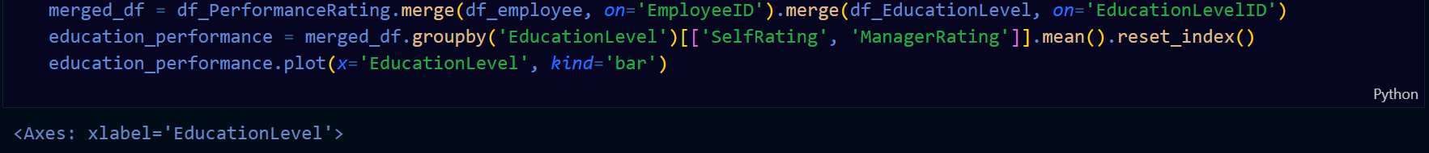
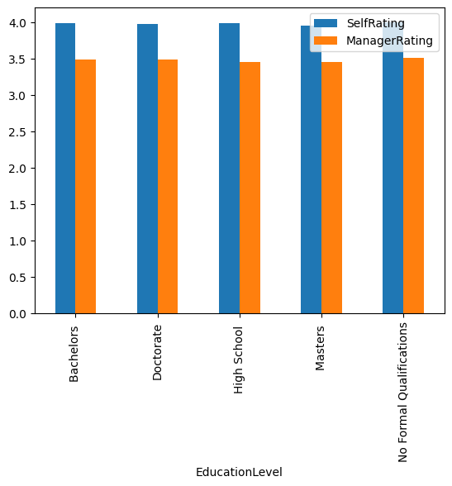

Slide 35
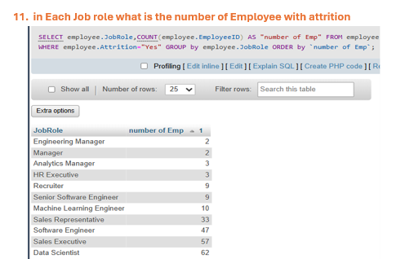
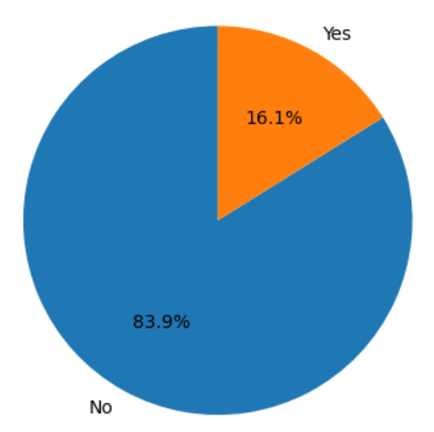
What is the percentage of attrition among employees?

Slide 36
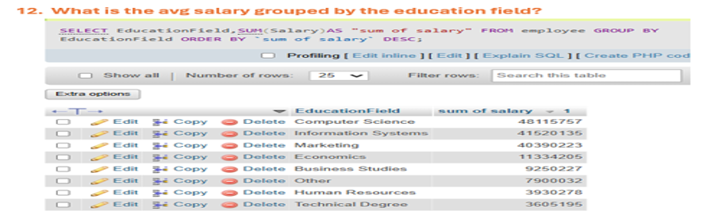
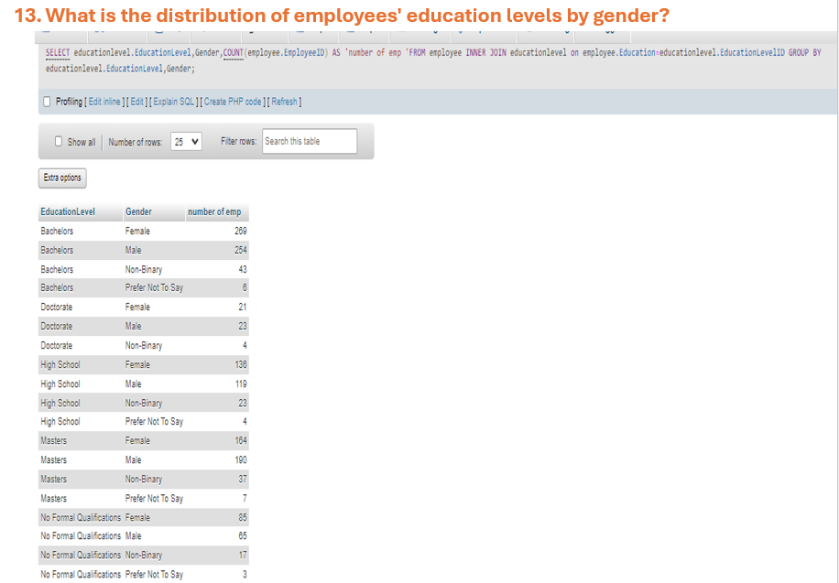


Slide 37
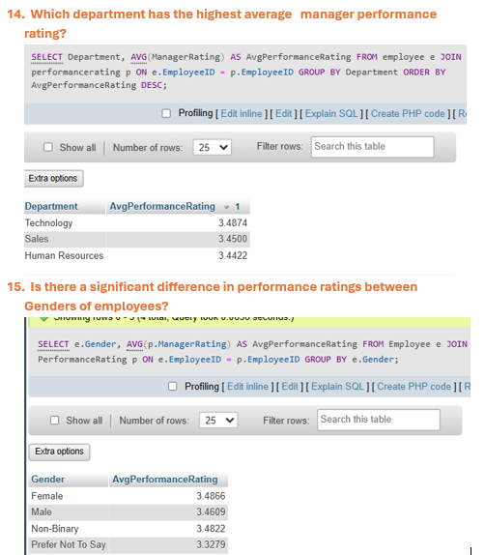

Slide 38
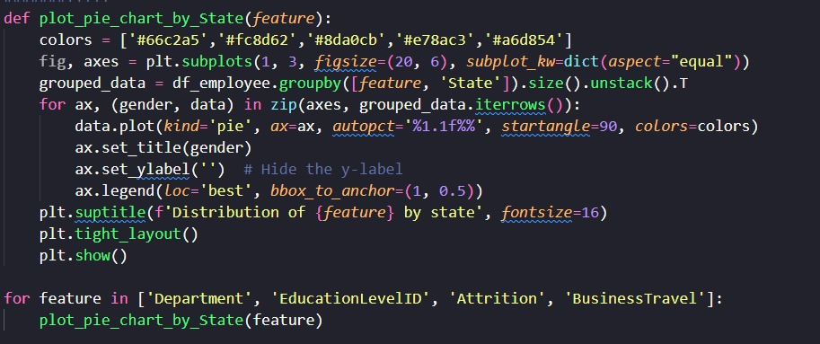
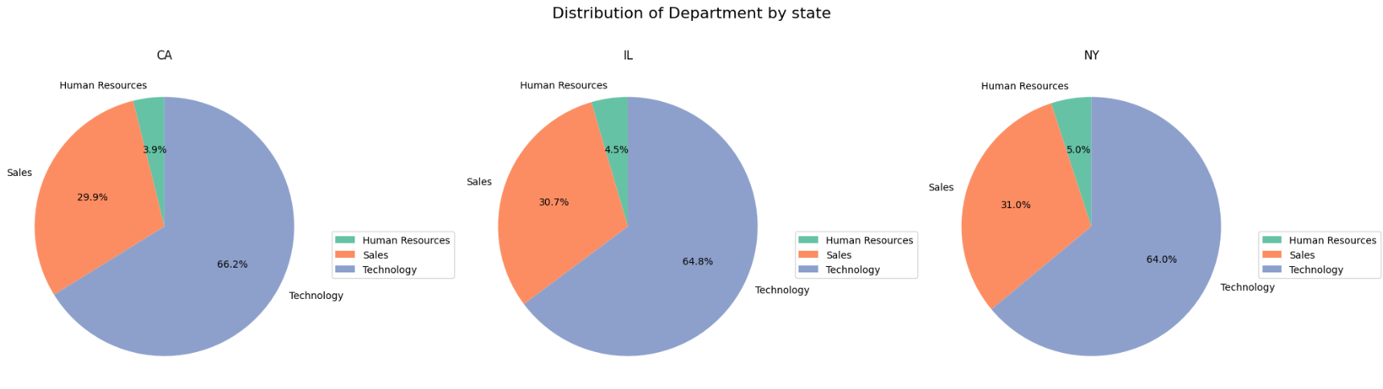
What Is The Effect Of The State On Other Parameters?

Slide 39
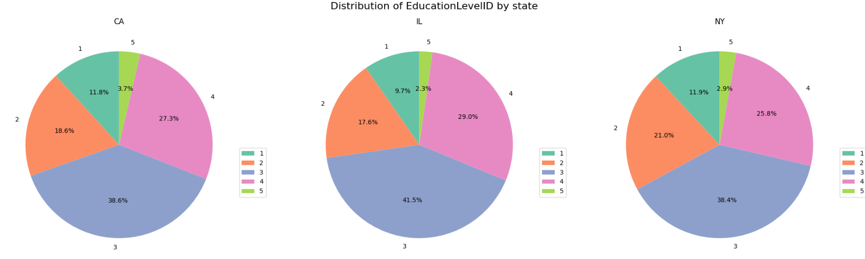
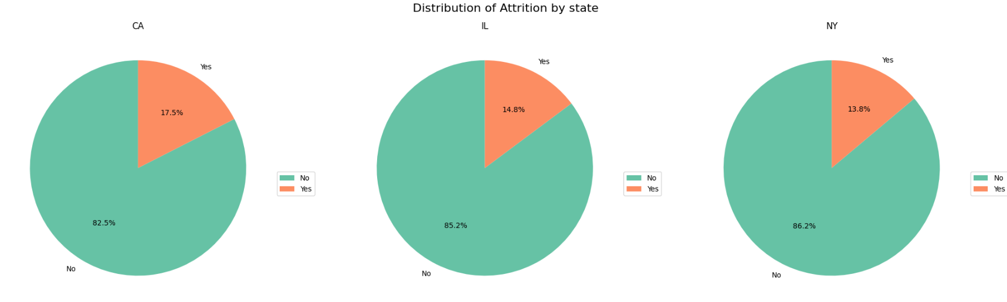

Slide 40
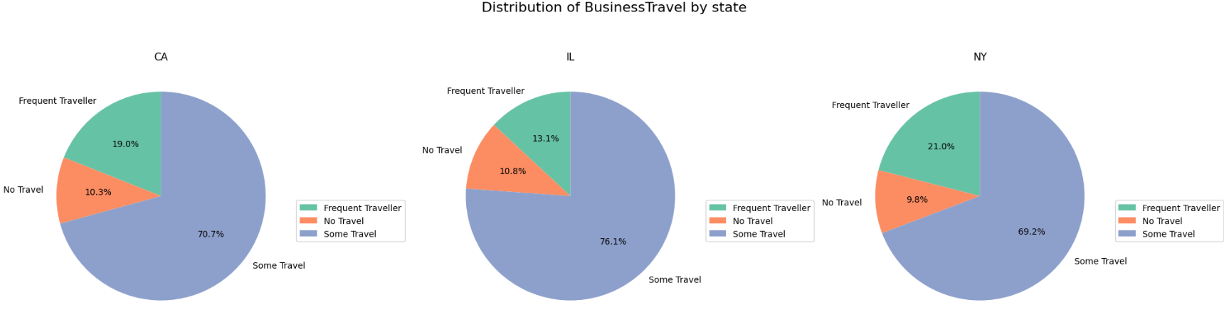

Slide 41
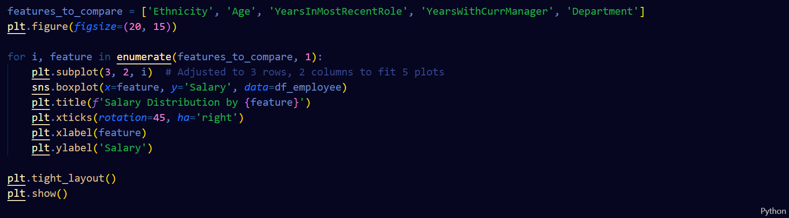
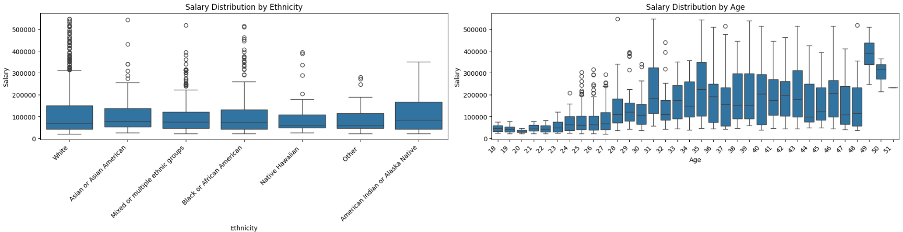
What Affects Employees Salaries?

Slide 42
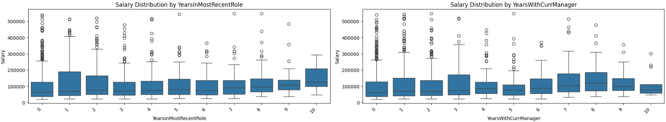
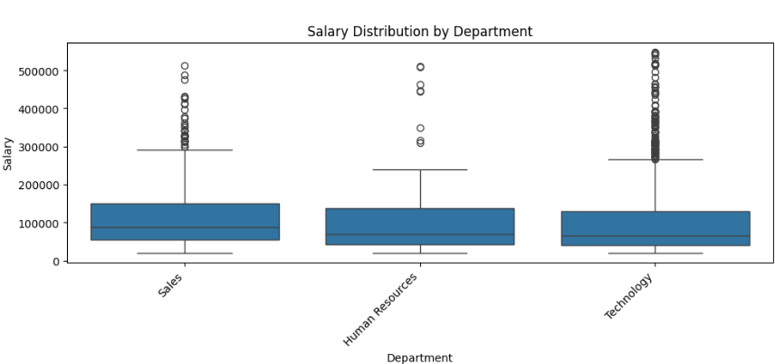

Slide 43


Slide 44


Slide 45


What Is The Average Of Salaries Overtime?

Slide 46

How Are Employees Distributed According To Ethnicity?

Slide 47

Which Departments Have More Business Travels

Slide 48




What Are The Main Causes Of Employees Attrition

Slide 49





Slide 50




What Is the effect of JobRole & Age On Attrition?

Slide 51


What Is The Effect Of Marital Status On Attrition?

Slide 53

Comment:
The Main Causes of Attrition are:

Slide 54
What Is The Percentage Of Employees With Stock Options?

Slide 55


What Is The Average Job Satisfaction By Department?

Slide 56




Which Ages Have More Job Satisfaction

Slide 57


Slide 58



Slide 59


Monthly Average Manager Rating Trend

Slide 60


Plotting Count Plots For Categorical Columns

Slide 61


Ploting Count Plots For Categorical Columns

Slide 62
Plotting Count Plots For Categorical Columns

Slide 63

Ploting Count Plots For Categorical Columns

Slide 64


Plotting Count Plots For Numerical Columns

Slide 65



Slide 66



Slide 67



Slide 68

Forecasting
1- Predecting The Number of Employees that may have attrition in the company by the next year
Import libraries and merge 2 tables in one new table

Slide 69



Slide 70


2- Predict the Avg Salary to Each Job role:

Slide 71


3- Which departments are likely to have the highest attrition rates next year?

Slide 72

Data Visualization

Slide 73

Ploting Count Plots For Numerical Columns

Slide 74


Slide 75


Slide 76


Slide 77


Slide 79


Slide 80


Slide 81


Slide 82


Slide 83

Please Listen to the Final Project Conclusion MP3 File

Slide 84
THANK YOU!

